Slide 1
BT 205: Cell & Molecular Biology
-Prof. Siddhartha Sankar Ghosh

Slide 2
Cell Signaling

Slide 3
Q How does an intracellular signaling pathway activated by an extracellular signal molecule?
The signal molecule usually binds to a receptor protein that is embedded in the plasma membrane of the target cell. The receptor activates one or more intracellular signaling pathways, involving a series of signaling proteins. Finally, one or more of the intracellular signaling proteins alters the activity of effector proteins and thereby the behavior of the cell.

Slide 4
Q. How many major classes of Cell-Surface receptor proteins are present?
Answer: Three classes of cell-surface receptors
(A) Ion-channel coupled receptors (also called transmitter-gated ion channels),
(B) G-protein-coupled receptors
(C) Enzyme-coupled receptors.

Slide 5
Q. How does Ion Channels work?

Slide 6
Q. How does opening of Acetylcholine-Gated Cation Channels Leads to Muscle Contraction?

Slide 7
Q. How does cycling of neurotransmitters and synaptic vesicles in axon terminals happen?

Slide 8
Sequential activation of gated ion channels at a neuromuscular junction
Arrival of an action potential at the terminus of a presynaptic motor neuron induces opening of voltage-gated Ca2 channels (step 1 )
Subsequent release of acetylcholine, which triggers opening of the ligand-gated acetylcholine receptors in the muscle plasma membrane (step 2 ).
The resulting influx of Na⁺ produces a localized depolarization of the membrane, leading to opening of voltage-gated Na⁺ channels and generation of an action potential (step 3 ).
When the spreading depolarization reaches T tubules, it is sensed by voltage gated Ca²⁺channels in the plasma membrane. This leads to opening of Ca²⁺release channels in the sarcoplasmic reticulum membrane, releasing stored Ca²⁺ into the cytosol (step 4 ). The resulting rise in cytosolic Ca²⁺ causes muscle contraction.

Slide 9
Q. How does G-protein coupled receptors (GPCR) work?

Slide 10
Q. How does Enzyme- Coupled receptors work?

Slide 11
Q. How many types of intracellular signaling proteins act as molecular switches?
Answer: Two types of intracellular signaling proteins that act as molecular switches.

Slide 12
Two types of intracellular signaling proteins that act as molecular switches.
(A) A protein kinase covalently adds a phosphate from ATP to the signaling protein, and a protein phosphatase removes the phosphate.
(B) A GTP binding protein is induced to exchange its bound GDP for GTP, which activates the protein; the protein then inactivates itself by hydrolyzing its bound GTP to GDP.

Slide 13
Q. How does downstream signals activate ?
Answer: Downstream signals are activated by protein phosphorylation

Slide 14
Oncogenes
An oncogene is a gene that has the potential to cause cancer.
In tumor cells, these genes are often mutated, or expressed at high levels.
Most normal cells will undergo a programmed form of rapid cell death (apoptosis) when critical functions are altered and malfunctioning.
Activated oncogenes can cause those cells designated for apoptosis to survive and proliferate instead.
Most oncogenes began as proto-oncogenes: normal genes involved in cell growth and proliferation or inhibition of apoptosis. If, through mutation, normal genes promoting cellular growth are up-regulated, they will predispose the cell to cancer; thus, they are termed "oncogenes".
Usually multiple oncogenes, along with mutated apoptotic or tumor suppressor genes will all act in concert to cause cancer.

Slide 15
List of Oncogenes

Slide 16
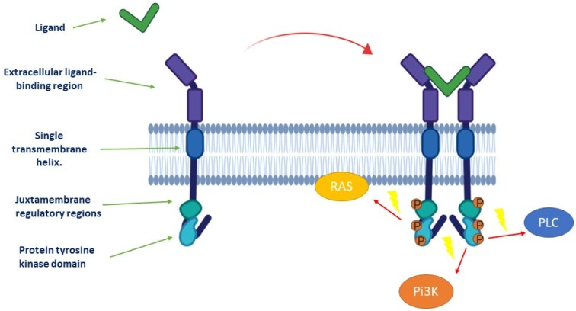
Activation of tyrosine kinase receptor. Ligand binding stabilizes connections between monomeric receptors to form an active dimer, which in turn activates the intracellular kinase. Three main effectors can be activated later: phosphoinositide 3-kinase (Pi3K), rat sarcoma (RAS), and phospholipase C (PLC).

Slide 17
Q. How does Tyrosine Kinase Inhibitors work in cancer treatments?
Answer: These inhibitors are sorted by their main targeted pathways and from signal initiation at cytoplasmic membrane of the cell to its propagation to the nucleus.

Slide 18
Cell dependance on multiple extracellular signal molecules

Slide 19
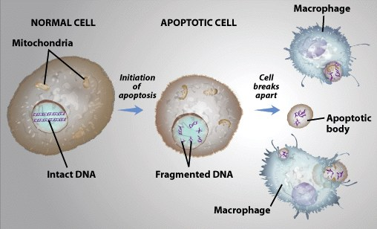

Slide 20
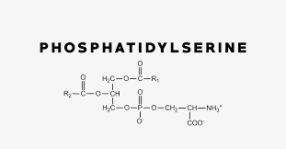

Slide 21
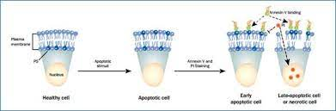
Phosphatidylserine Externalization in Apoptosis

Slide 22
Two Important Players
Annexin V is a cellular protein in the annexin group. In flow cytometry, annexin V is commonly used to detect apoptotic cells by its ability to bind to phosphatidylserine, a marker of apoptosis when it is on the outer leaflet of the plasma membrane.
Propidium iodide (or PI) is a fluorescent intercalating agent that can be used to stain cells and nucleic acids. PI binds to DNA by intercalating between the bases with little or no sequence preference.

Slide 23
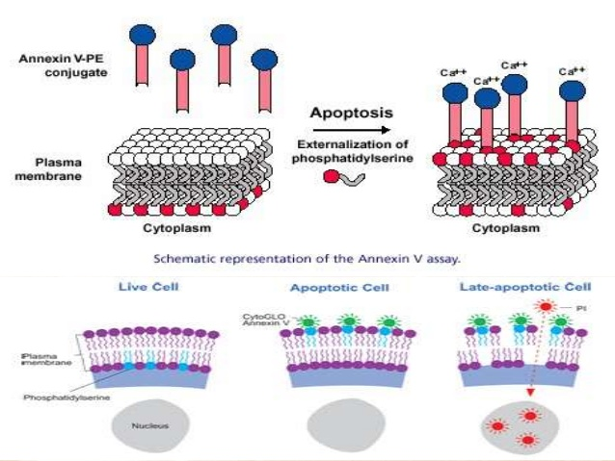
Apoptosis Detection

Slide 24
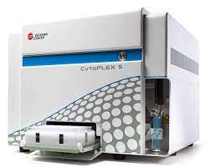
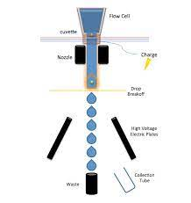
Flow Cytometer [FACS: Fluorescence activated cell sorting]

Slide 25

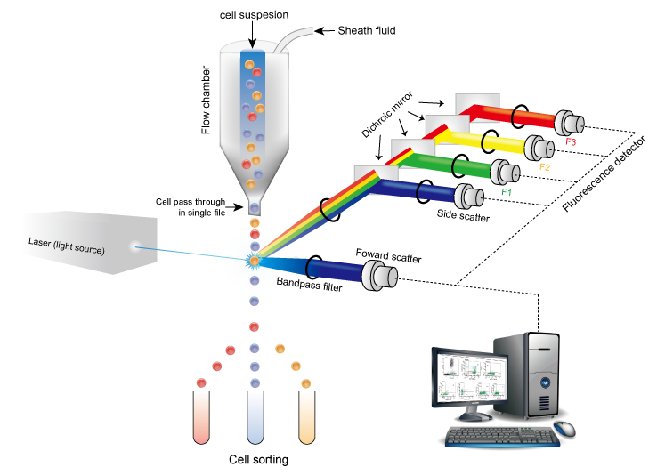
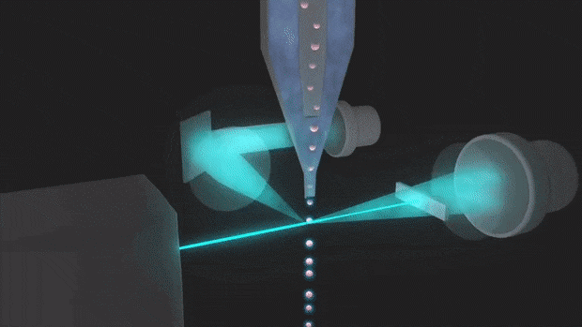
https://www.itrlab.com/receptor-occupancy-measurement-by-flow-cytometry/

Slide 26
FLOW CYTOMETRY
Flow Cytometry is a technique used to detect and measure physical and chemical characteristics of a population of cells or particles.
Flow cytometry provides a well-established method to identify cells in solution and is most commonly used for evaluating peripheral blood, bone marrow, and other body fluids. Flow cytometry studies are used to identify and quantify immune cells and characterize hematological malignancies. They can measure:
Cell size
Cell granularity
Total DNA
The ability to perform these measurements in a very rapid time span is one of the key advantages of the flow cytometric process. They can quantify up to three to six properties or components are quantitated in a single sample, cell by cell, for about 10,000 cells, in less than one minute.

Slide 27
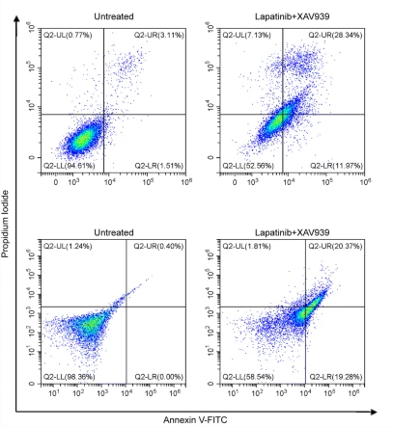
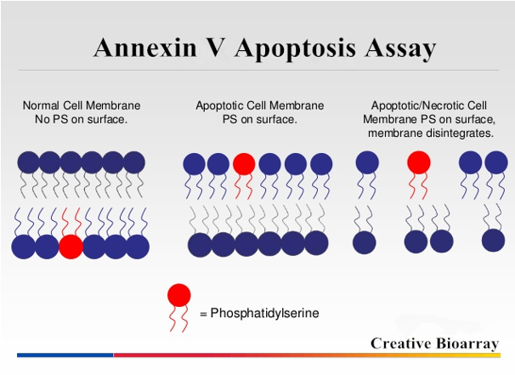
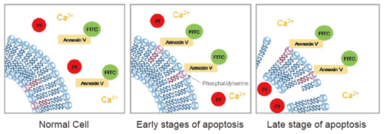
Apoptosis Detection

Slide 28
THANK YOU

